Slide 1
Introduction to Web-Based Java Applications (PRJ301)

Slide 2
Prerequisites
Completed:
PRO192 (Object Oriented Programming)
DBI202 (Database Systems)

Slide 3
Course Objectives
This course explores the features of JavaEE (J2EE)
Understand the core technologies of Java web programming (Servlets, JSP, JavaBeans, Custom Tags, Filtering)
Understand and be able to apply MVC architecture for the web combining with framework (Struts 2)
Develop a Web Application (Servlets, JSP)

Slide 4




MVC Design Pattern Model – View – Controller
Sees
User
Uses
Updates
Manipulates
View
Controller
Model
This is a MVC Model

Slide 5
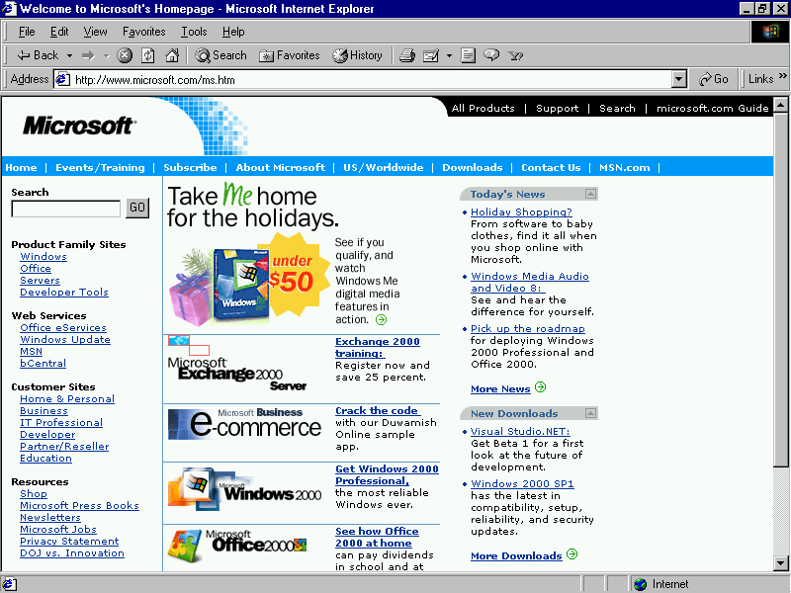
Course Objectives
The MVC architecture is applied in web application

Slide 6
Course Objectives
The MVC architecture is applied in web application
Web Server
Container

Slide 7
Course Objectives
The MVC architecture is applied in web application
Web Server
Container
C
M
V

Slide 8
Course Objectives
The MVC architecture is applied in web application
Web Server
Container
C
DB
M
V

Slide 9
Course Objectives
The MVC architecture is applied in web application
Web Server
Container
C
DB
1
M
V

Slide 10
Course Objectives
The MVC architecture is applied in web application
Web Server
Container
C
DB
1
2
M
V

Slide 11
Course Objectives
The MVC architecture is applied in web application
Web Server
Container
C
DB
1
2
3
M
V

Slide 12
Course Objectives
The MVC architecture is applied in web application
Web Server
Container
C
DB
1
2
3
M
V

Slide 13
Course Objectives
The MVC architecture is applied in web application
Web Server
Container
C
DB
1
2
3
M
V

Slide 14
Course Objectives
The MVC architecture is applied in web application
Web Server
Container
C
DB
1
2
3
4
M
V

Slide 15
Course Objectives
The MVC architecture is applied in web application
Web Server
Container
C
DB
1
2
3
5
4
M
V

Slide 16
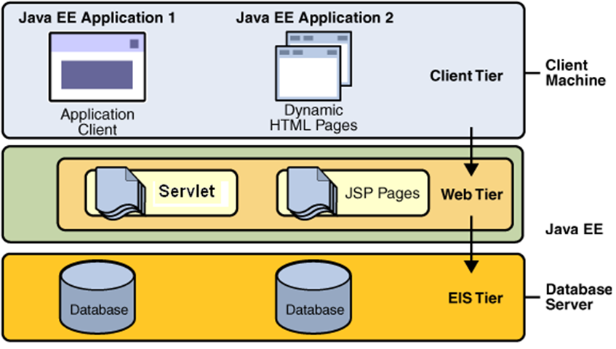
Course Objectives

Slide 17
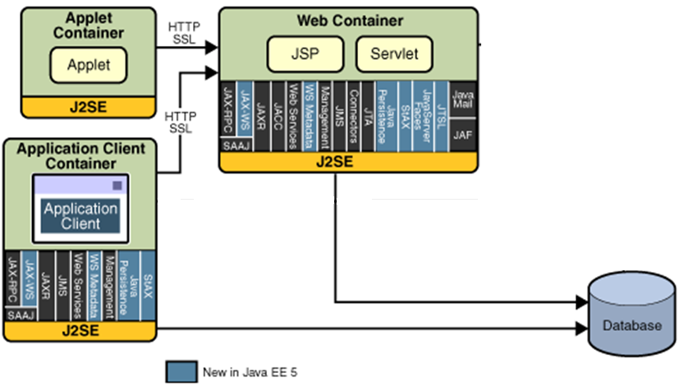
Course Objectives
J2EE 1.4/ JavaEE5/ JavaEE6 Platform API

Slide 18
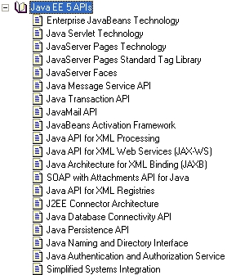
Course Objectives
J2EE/JavaEE Technologies

Slide 19
Course Description
Servlets Model
Web Application & Web Container
Java Server Pages (JSP)
Session Management
JavaBeans
JSP Tag Libraries – Custom Tags
Filters
Introduction to Struts
Struts 2 Basics
Struts 2 Advanced

Slide 20
Course Plan
See course plan on LMS
Web based App - PBL
Web
Day 1, 2, 3 – Login
Servlet
Day 4, 5 – Search
Break Down
Framework
Day 6, 7 – MVC2
JSP
Day 8, 9, 10 – CUD, Shopping Carts
Sessions
Day 11, 12 – Login
JavaBeans
Day 13, 14, 15 – CRUD
MVC 2 Complete - JSTL - Taglib
Day 16, 17 – Filter
Filter Chain

Slide 21
Course Plan
See course plan on CMS
Web based App - PBL
Web
….
Framework
Day 18, 19 – Login
Struts
Day 20, 21, 22 – CRUD
Struts 2
Day 23, 24, 25 – Advanced
Struts 2 Advanced

Slide 22
Course Plan
See course plan on LMS
Agenda
The Servlet Model
Web Application & Web Container
Java Server Pages (JSP)
Session Management, Session & Listener (self-study)
JavaBeans
JSP Tag Libraries – Custom Tags
Filters
Introduction to Struts
Struts 2
Strut2 Advanced
Practical test
Project Presentation

Slide 23
Materials/ References
Required Textbook
Online Text book: Nicholas S. Williams, 2014, Professional Java® for Web Applications, Wrox Press
http://library.books24x7.com/toc.aspx?bookid=62587
Required References
http://java.sun.com/docs/books/tutorial/jdbc/
http://struts.apache.org/
References
http://java.sun.com/
Fan Page: https://www.facebook.com/TrongKhanh.Kieu/

Slide 24
Learning Environments
JDK 7 (http://www.oracle.com/technetwork/java/index.html )
Recommend: JDK 7 Update 51, JDK 8 Update 66
JDK 7 Documentation
J2EE 1.4/JavaEE5 Core Patterns
NetBeans IDE 7.4/8.0.2/8.1/8.2 with supporting JavaEE (http://www.netbean.org)
Bundle Tomcat 8.0.x/7.0.x (http://tomcat.apache.org/ )
DBMS: MS. SQL Server 2005/2008/2014 (http://www.microsoft.com/sqlserver/2008/en/us/default.aspx )
Browser: Internet Explorer ≥ 8.x
Driver Type 4 for MS. SQL Server: sqlserver4.jar (http://lms-undergrad.fpt.edu.vn/mod/resource/view.php?id=4566 )
Team Viewer for supporting
Notes:
Bundle: bó, bọc vào

Slide 25
Course Rules
How to conduct
Prepare contents of the next session/ topic at home
Following lessons in classrooms and review previous session at the beginning of class in every day (penalty marks on workshops)
Completing chapter assessments in time and Quizzes (via LMS)
Communication
Class
Interchange by FU-HCM LMS, Forum
Discussing actively in your teams and in classrooms
Free to question and answer
Others
Off phone
Use laptops under teacher’s instruction (No game, no chat in class)

Slide 26
Evaluation Strategy
Must attend more than 80% of contact hours (if not, not allow to take exam).
Evaluating
02 Progress Test (Q) 10 %
02 Workshop (Lab) 10 %
01 Assignment (Prj) 30 %
01 Practical Exam (P) 20 %
Final Exam (FE) 30 %
Total score
10% (Q) + 10% (Lab) + 30% (Prj) + 20% (P) + 30% (FE)
Pass
Total score ≥ 5 and Final Examination ≥ 4 (of 10)
Every components > 0
Retake only the Final Exam when not passed

Slide 27
How to study
This course is complex knowledge (however, it’s attractive and exciting), so you need to keep tight grip on it
Read
On the books to get the general concept
Reference, study, collection from internet, your classmates, forum …
Attend lectures
Listens, understand, then make your own notes
Give your explanation about some topic in lectures
Ask questions
Give some examples that are not existed in your book
Practice all the exercises, demo to make your sense
After classes
Discuss your classmate in directly, on forum
Do the lab, assignments to submit via CMS, and do more exercises
Build your teams in yourselves to support together in studying
→ Make question to deposit marks for components in progress

Slide 28
How to exam/test
This course is required following rules, so you need to focus and practice your exercises and homework in try your best everyday
Progress Tests (if students violate, they take 0 marks)
No books and No conversations
Practical Exam (if students violate, they take 0 marks)
Obey requirements and lecturer’s recommended in his lecture
No internets, No emails, No chats, No conversation
Not copy or paste from available/previous code.
All are try it yourselves manually
… Nothing else
You do only work with Netbeans IDE tools and DBMS. (without configuring svn)
Workshop/Assignment (if students violate, they take 0 marks)
Obey requirements and lecturer’s recommended in his lecture
Not copy (copy code, contents, style)
Submission of all source code does not delete anything

Slide 29
Academic policy
Cheating, plagiarism and breach of copyright are serious offenses under this Policy.
Cheating
Cheating during a test, making a project, or an exam is construed as talking, peeking at another student’s paper, or any other clandestine method of transmitting information.
Cheating during in making lab and assignment as copy source code, copy style, same meaning in progress, …
To verify, student’s code in project can be deleted, then he/she must be retyped to make the program running correctly. Or/And make new required functions (Otherwise, he/she takes 0 marks for his/her project/quiz)
Plagiarism
Plagiarism is using the work of others without citing it; that is, holding the work of others out as your own work.
To verify, student must be described functionality dataflow and how it work (Otherwise, he/she takes 0 marks for his/her project)
Breach of Copyright
If you photocopy a textbook without the copyright holder's permission, you violate copyright law.

Slide 30
Enjoy the Course
Be enthusiastic about the material because it is interesting, useful and an important part of your training as a software engineer.
Our job is to help you learn and enjoy the experience.
We will do our best but we need your help.
So, let’s all have fun together with Web-Based Java Applications!!!

Slide 31
Q & A

